Slide 1
DanNet
Semantic web app hydration
Presented by Simon Gray
at the CST Pipeline Workshop
2022-04-28

Slide 2
Overall goal
Modern, integrated dataset (RDF w/ schema)
DanNet (old export)
COR-K
Sentiment lexicon
…. plus new additions to DanNet
Web presence
For browsing the RDF graph
Eventually a tool for editing DanNet

Slide 3
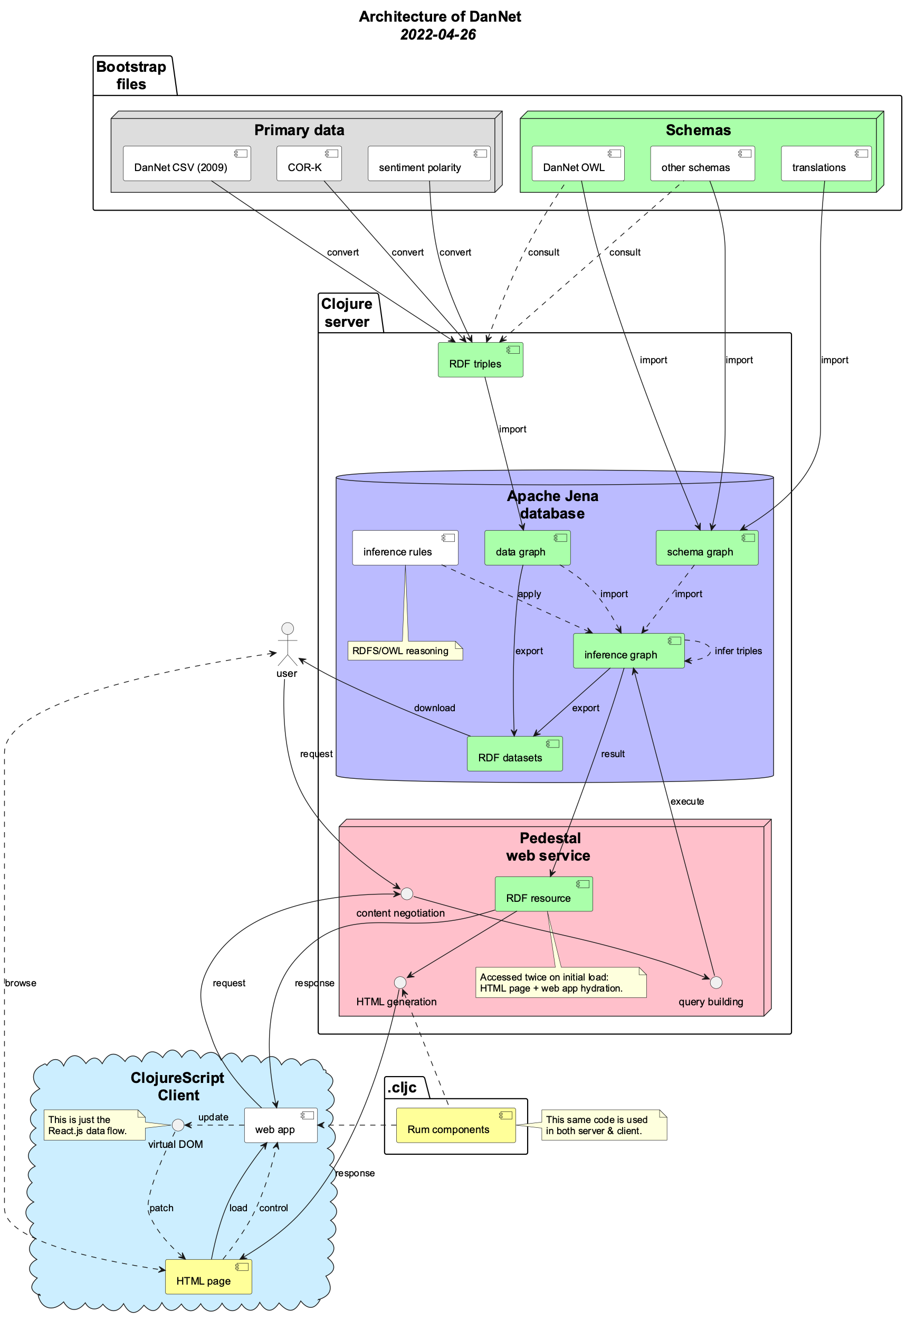
Architecture: pipeline + loop
Bootstrap files
Graph database
Web service
Client application

Slide 8
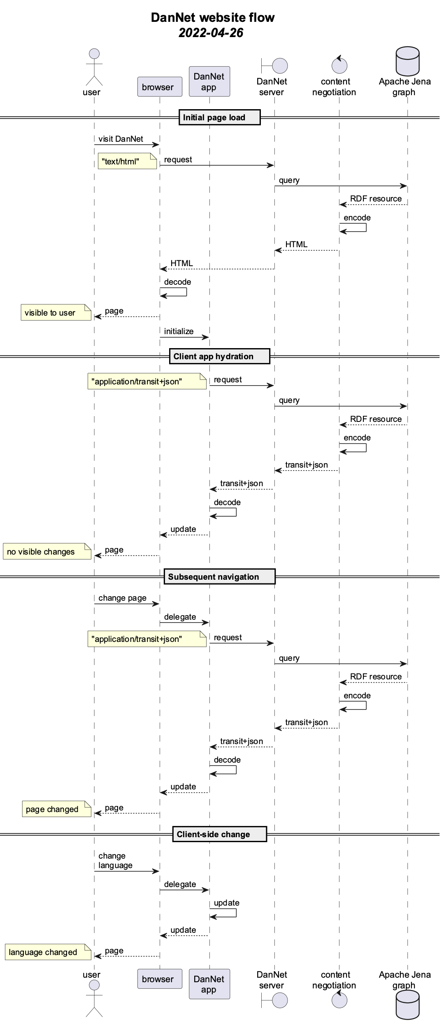
DanNet website (1)
Server-side rendering
Traditional approach
Browser requests HTML
Server sends HTML
Browser renders page from HTML
Client-side rendering
Single-page app AKA ”rich client”
Server exposes an API
App requests data
Server sends data
App renders page from data

Slide 9
DanNet website (2)
Hybrid approach
Browser requests HTML
Server sends HTML
Browser renders page from HTML
(single-page app is initialised)
…
Server exposes an API
Client requests data
Server sends data
Client renders page from data

Slide 11
